Slide 1

Cardiovascular Analysis
Chi - Scrum Master / Developer
Gabby - Developer
Alejandro - Developer

Slide 2
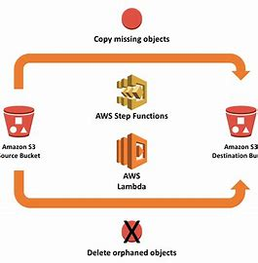
Introduction
We aim to establish a streamlined data pipeline in a cloud environment
Integrating Amazon S3 buckets
Lambda functions
RDS
Potentially EC2
This is crucial for organizations aiming to derive actionable insights from their data assets effectively, enabling informed decisions.

Slide 3
Objectives & Issues
Use dataset (Cardiovascular Disease) to run analysis on our local machine:
Creating an S3 bucket
Creating an RDS
Creating a triggering Lambda function
Pull data from the cloud environment and run analysis
Issues: Although we were able to successfully build this infrastructure, we ran into some issues
Incomplete data (only about a ⅓ of our data was displayed
Permissions (Access denied)

Slide 4
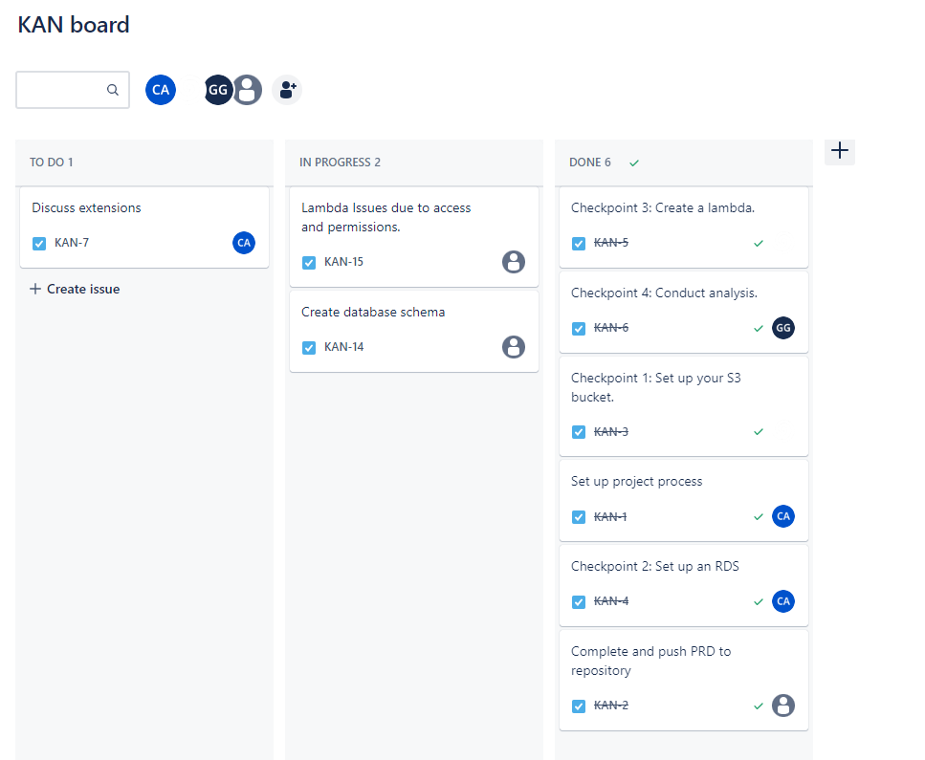
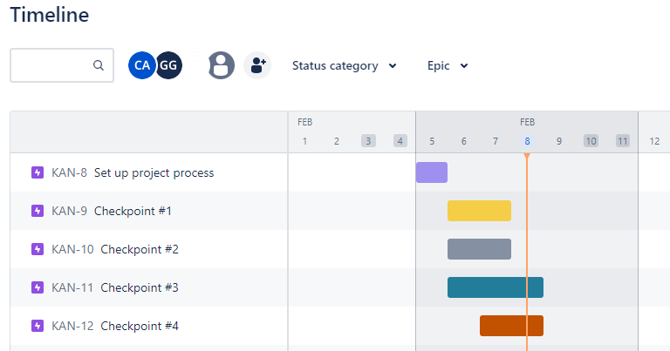
Project Tracking
We used Jira to track our progress

Slide 5
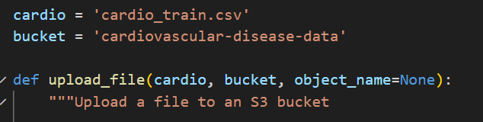
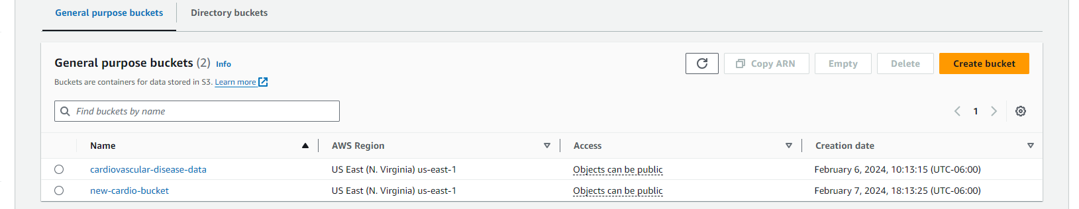
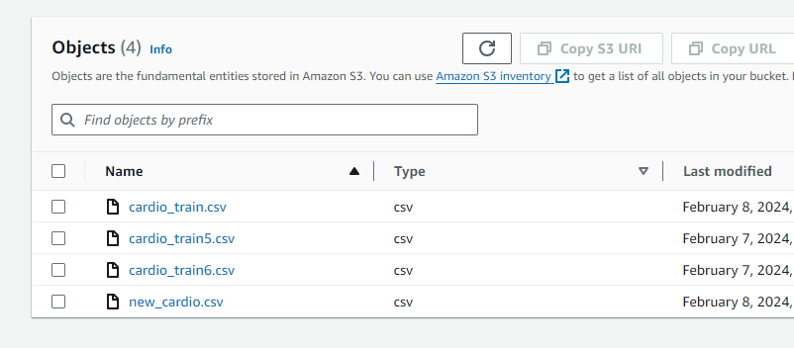
Checkpoint 1: Create S3 bucket
After specifying the bucket name and additional configuration, we were able to successfully create a bucket.
IAM users were created and given permission to access the bucket.

Slide 6
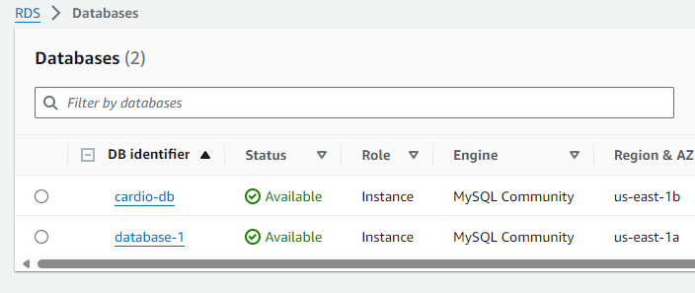
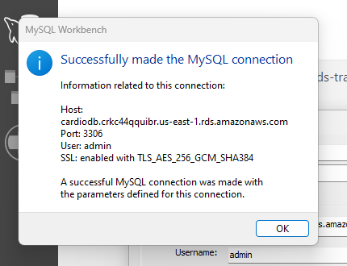
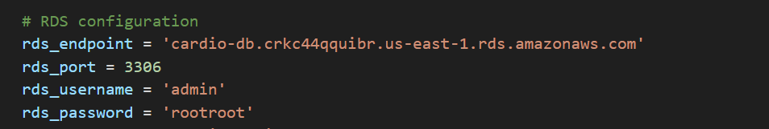
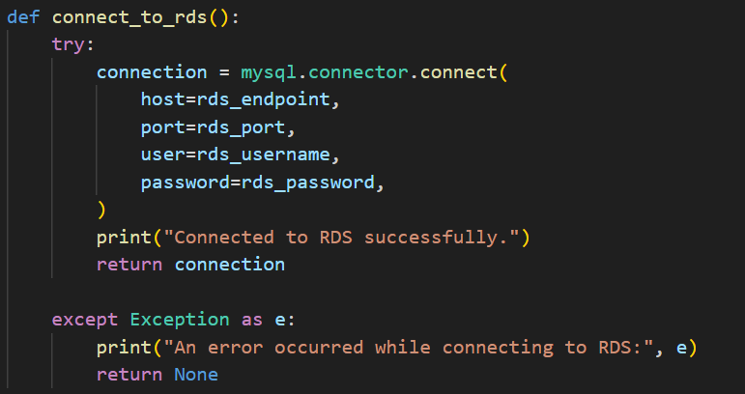
Checkpoint 2: Create RDS
Used AWS console to create and configured the RDS.

Slide 7
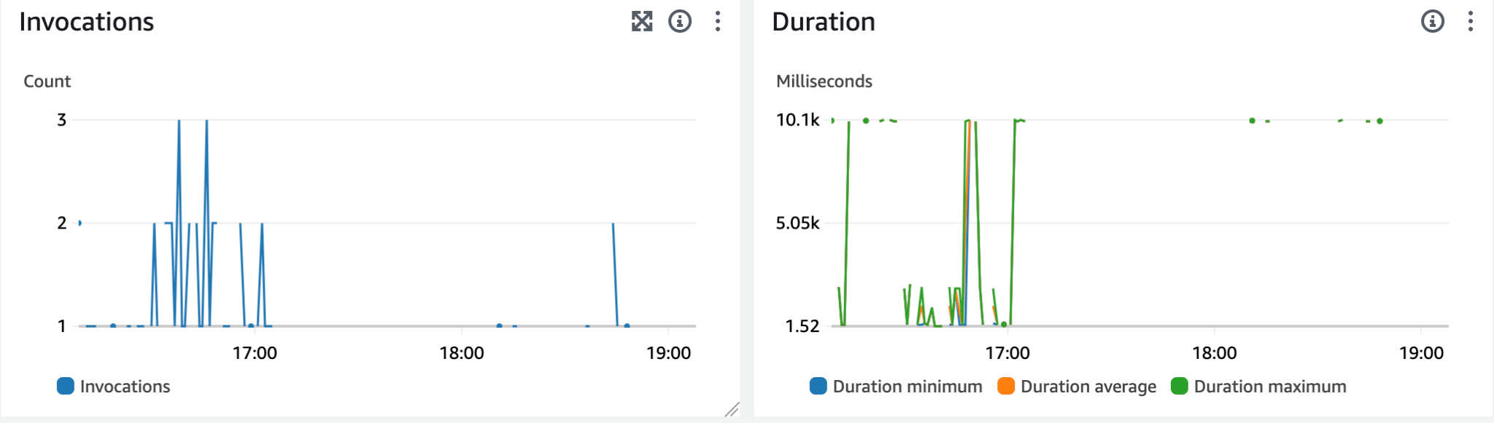
Checkpoint 3: Create a Lambda function
This function will act as a triggering event
Listening for any activity in the s3 bucket
Cleaning the data and registering it to the rds database.
Creating the Lambda from the rds.
Creating a direct connection to the rds proxy

Slide 8
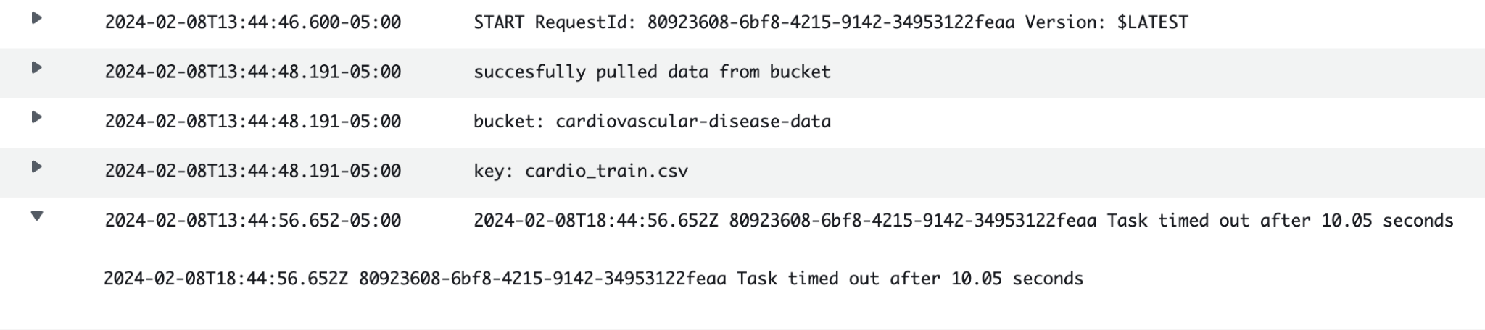
Issues
Lambda Issues:
Permissions
Getting the correct access for the correct actions
Timeouts
Understanding where and why the data was not being processed successfully
Troubleshooting
Using standard debugging technique and pair programing to pinpoint a solution

Slide 9
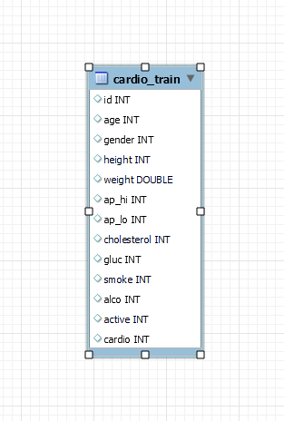
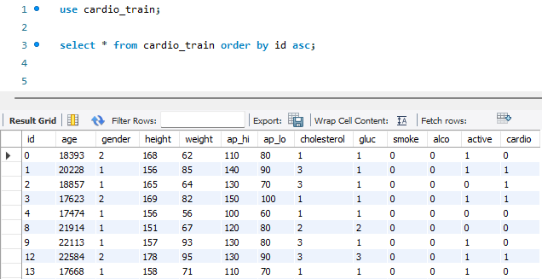
Database
All the information needed (ex. patient information and details) - was stored under the same table.

Slide 10
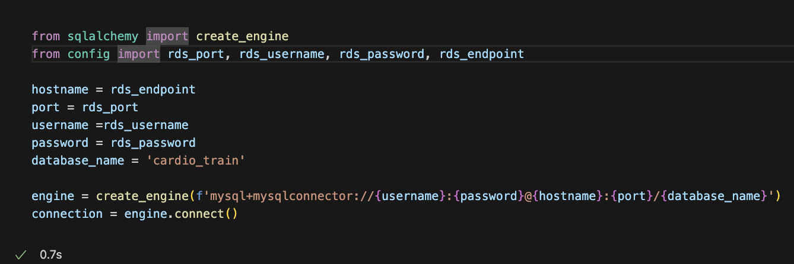
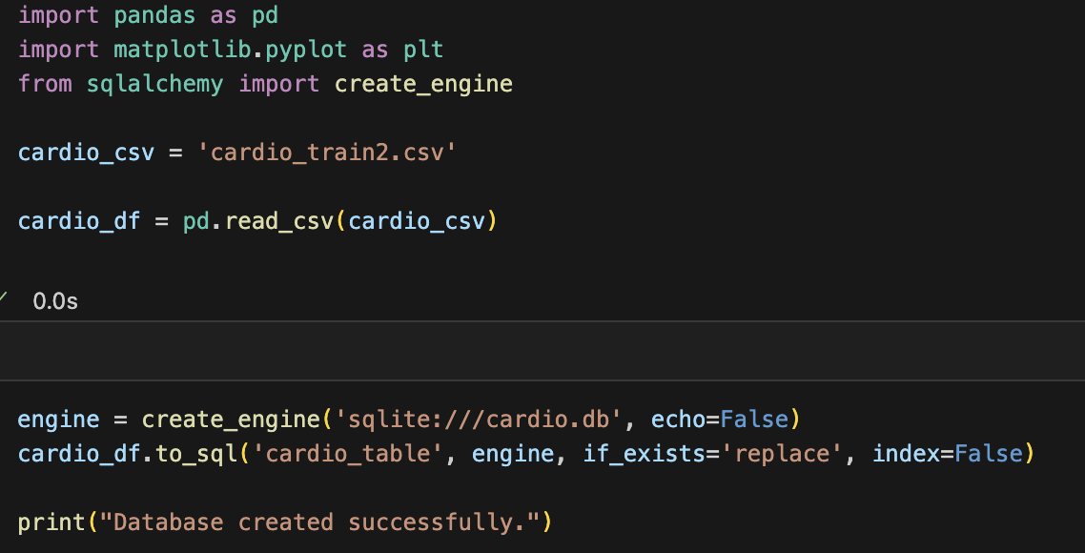
Checkpoint 4: Data Analysis
Checkpoint 4- Pull Data from RDS to create meaningful insight
To uncover patterns, correlations and potential risk factors related to cardiovascular disease we used:
Pandas
Maplotlib.pyplot
Sqlalchemy to create engine

Slide 11
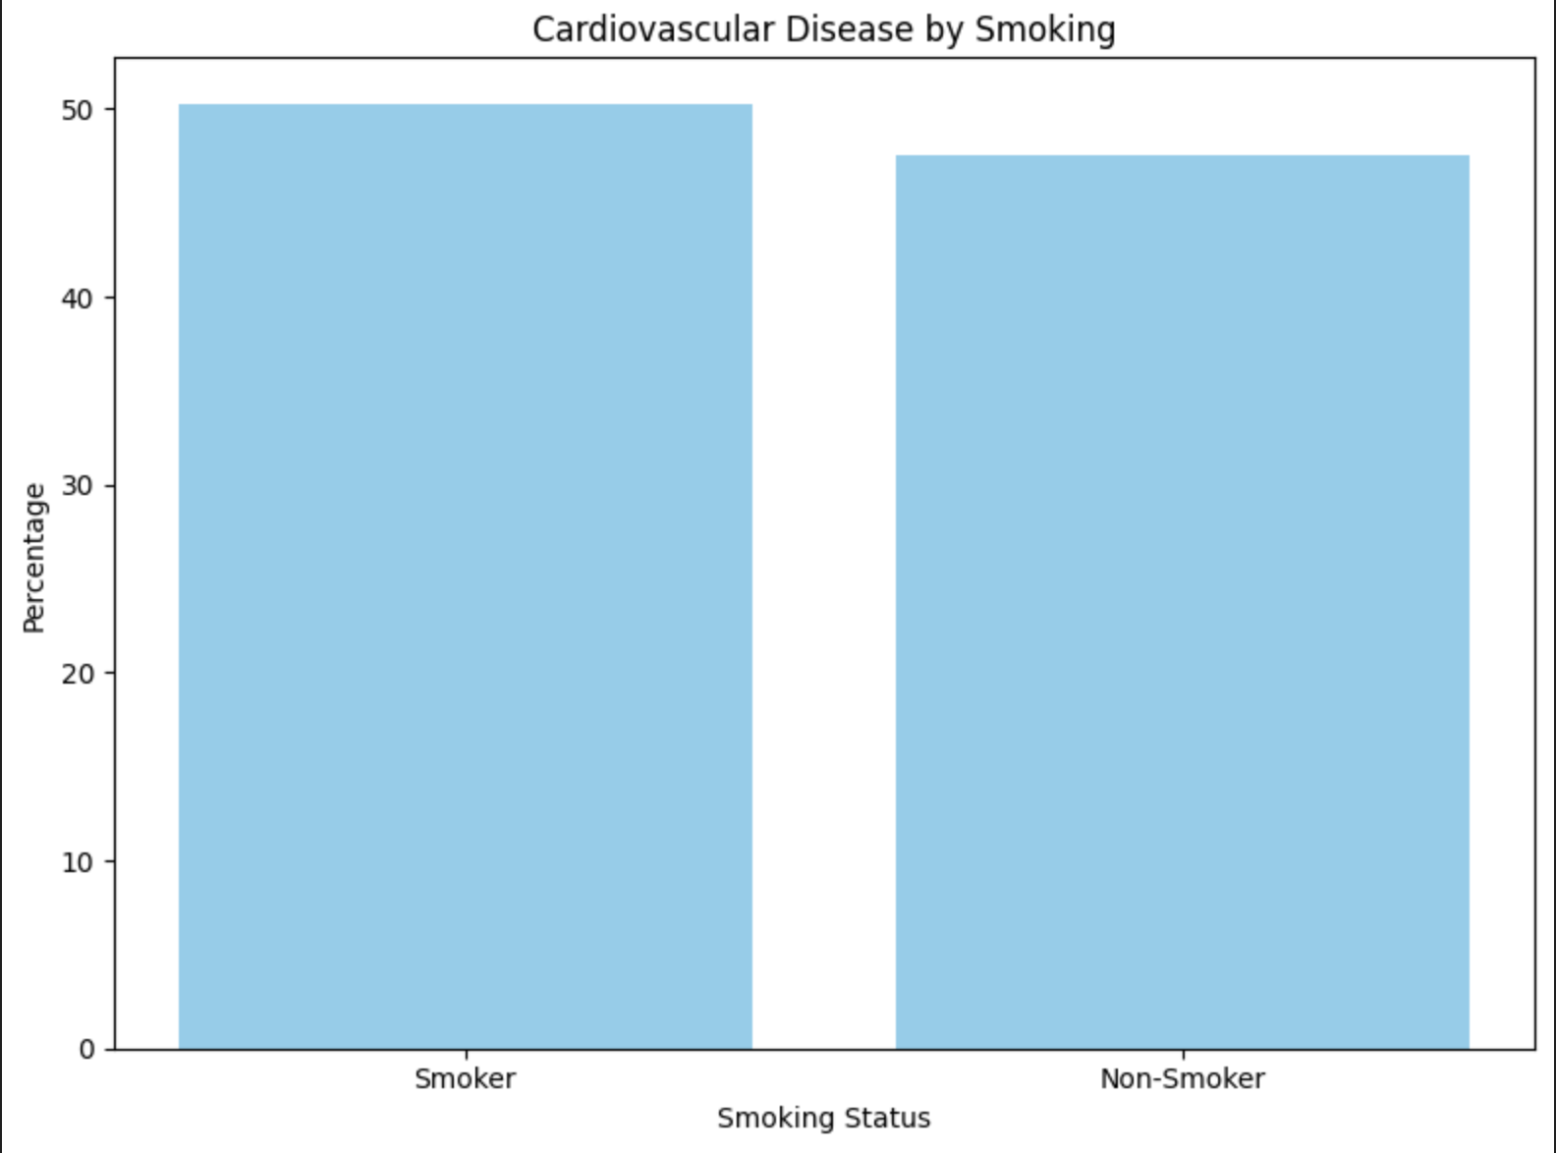
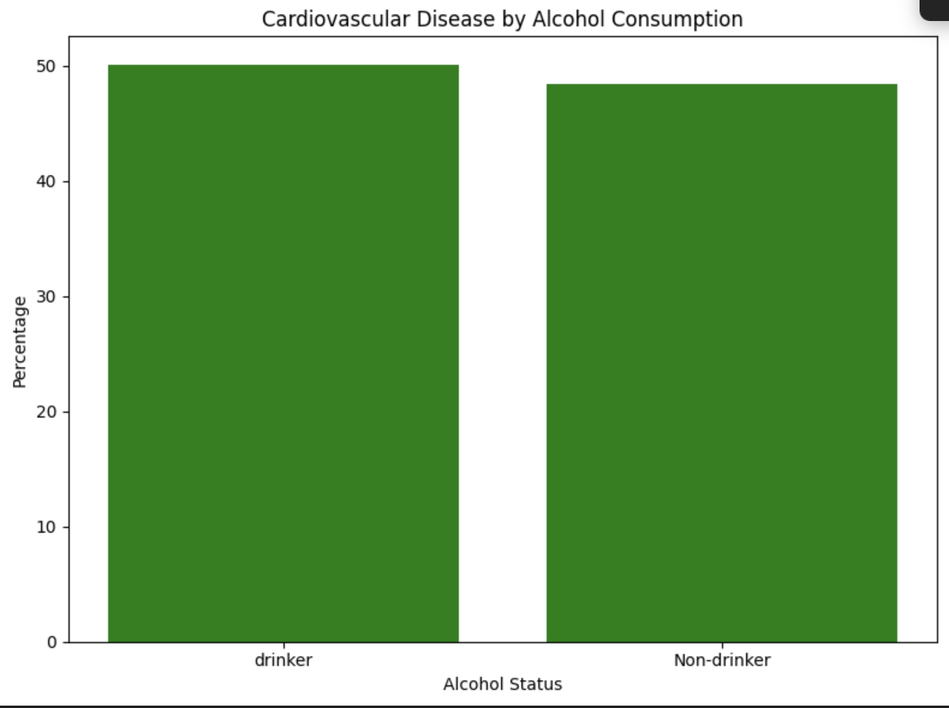
Impact to Lifestyle
Both Alcohol consumption and Smoking should increase the risk of cardiovascular disease. However from the data set everything was almost split evenly.

Slide 12
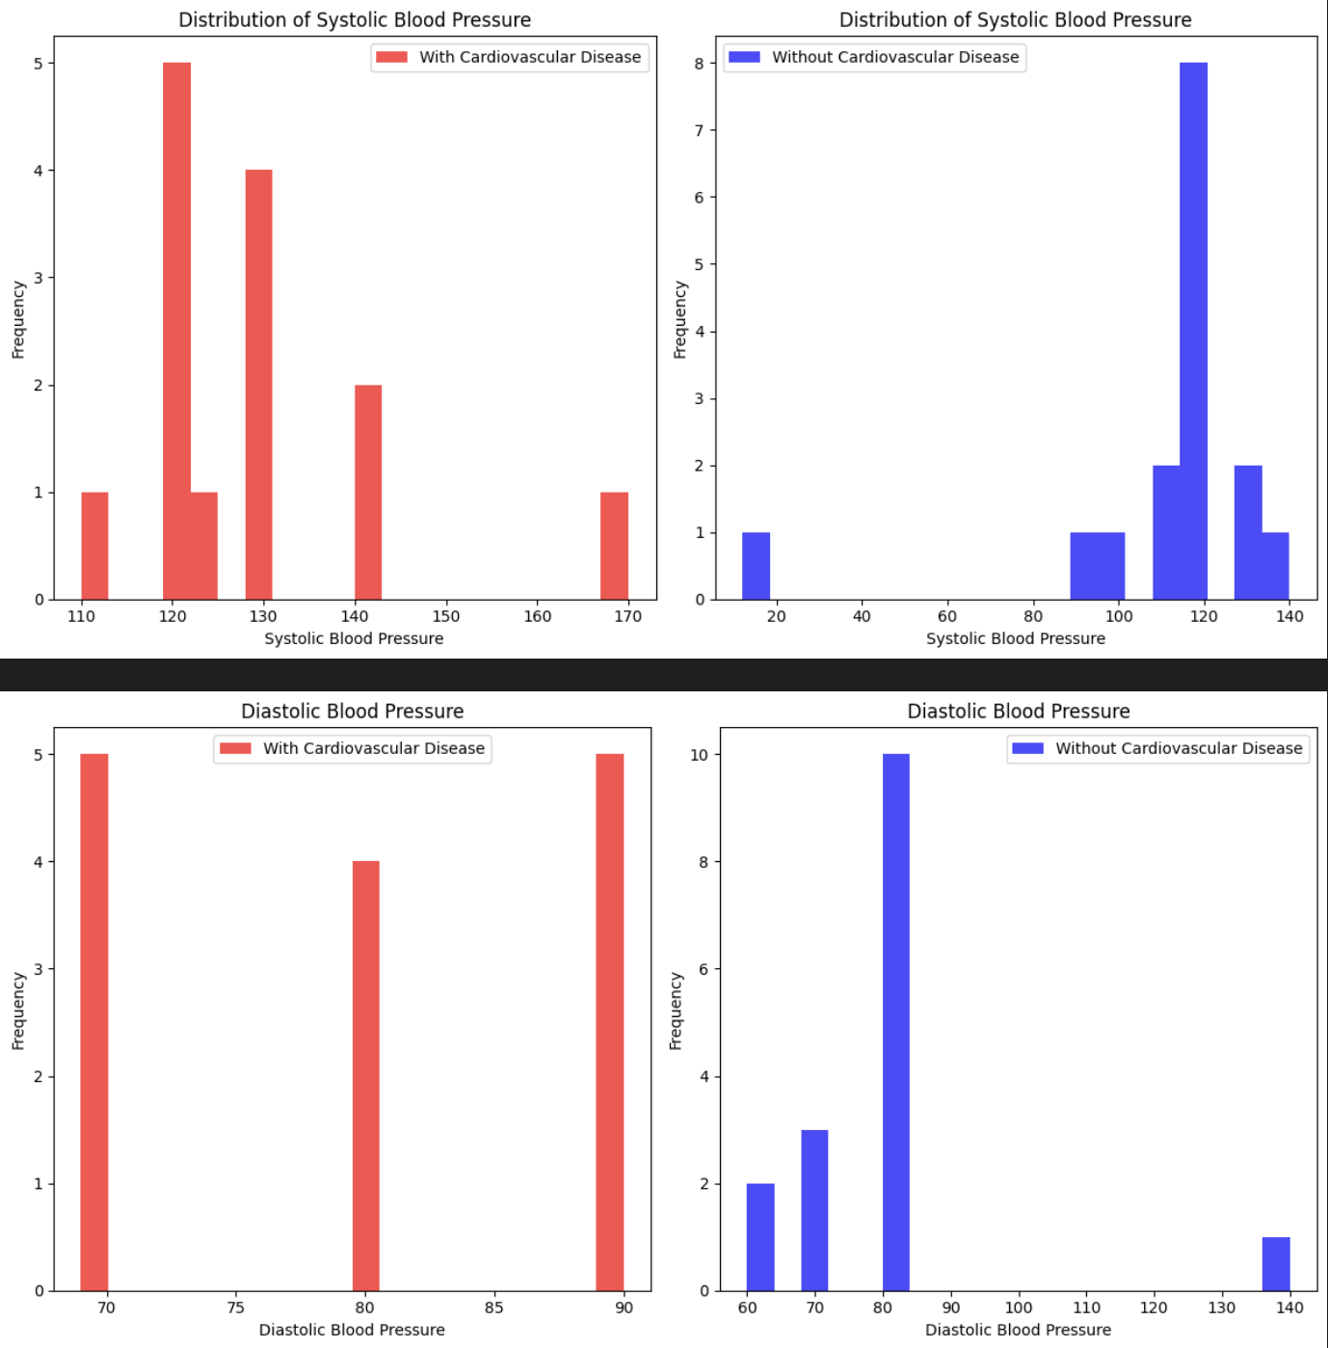
Blood Pressure and Cardiovascular Disease
Normal blood pressure for most adults is defined as a systolic pressure of less than 120 and a diastolic pressure of less than 80. Elevated blood pressure is defined as a systolic pressure between 120 and 129 with a diastolic pressure of less than 80.

Slide 13
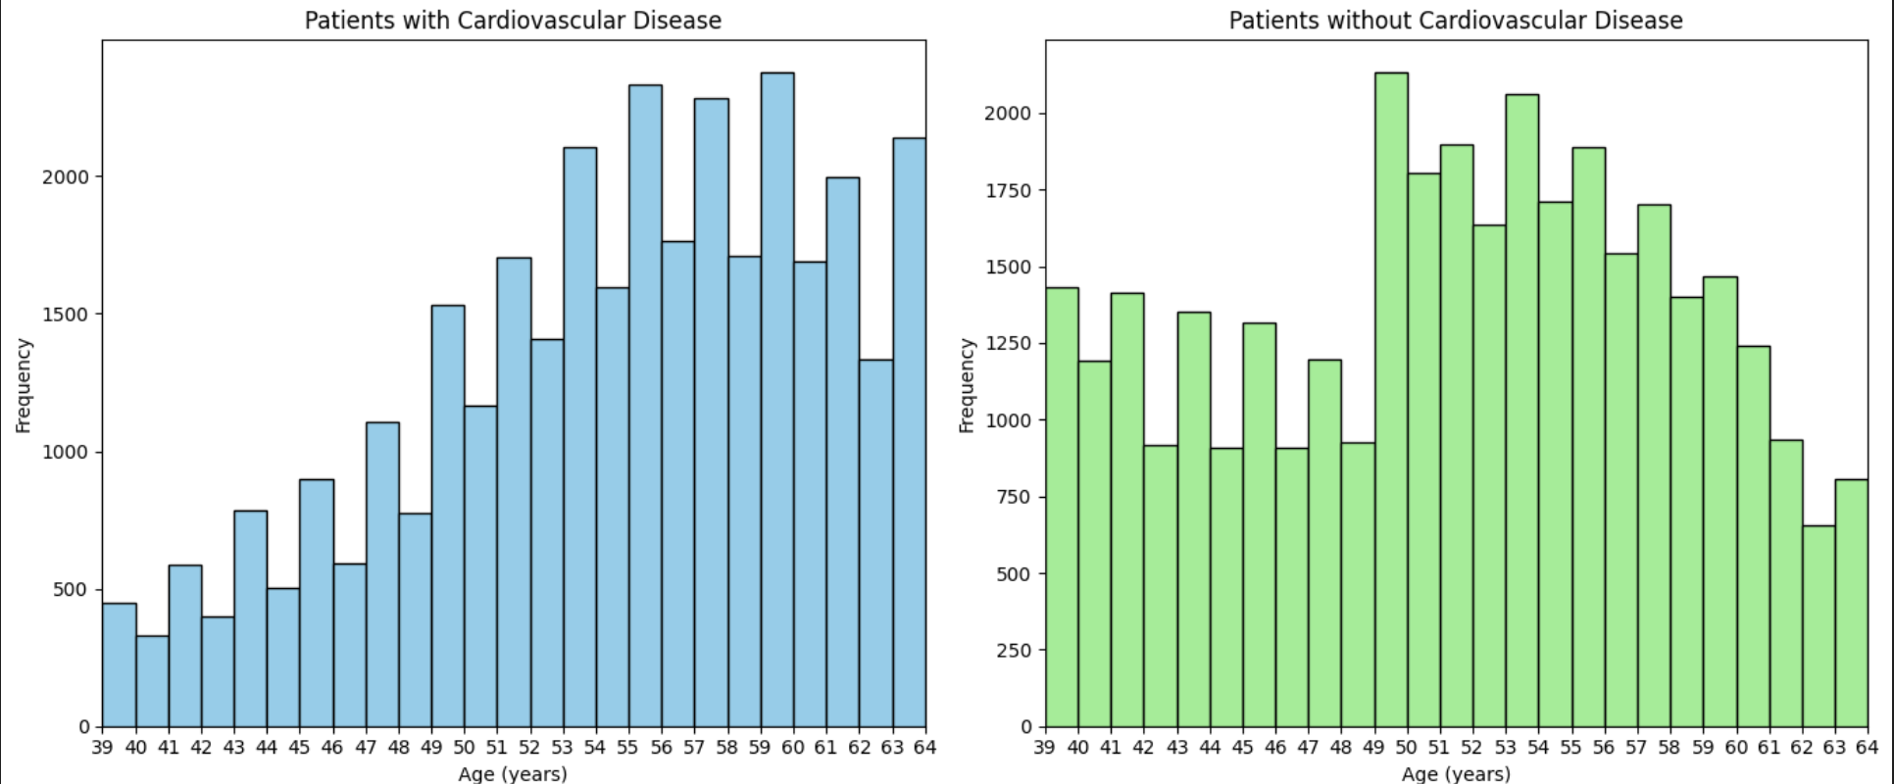
Age Distribution
The first graph is the main one used for analysis. We can see with an increase of age the risk of cardiovascular disease.

Slide 14
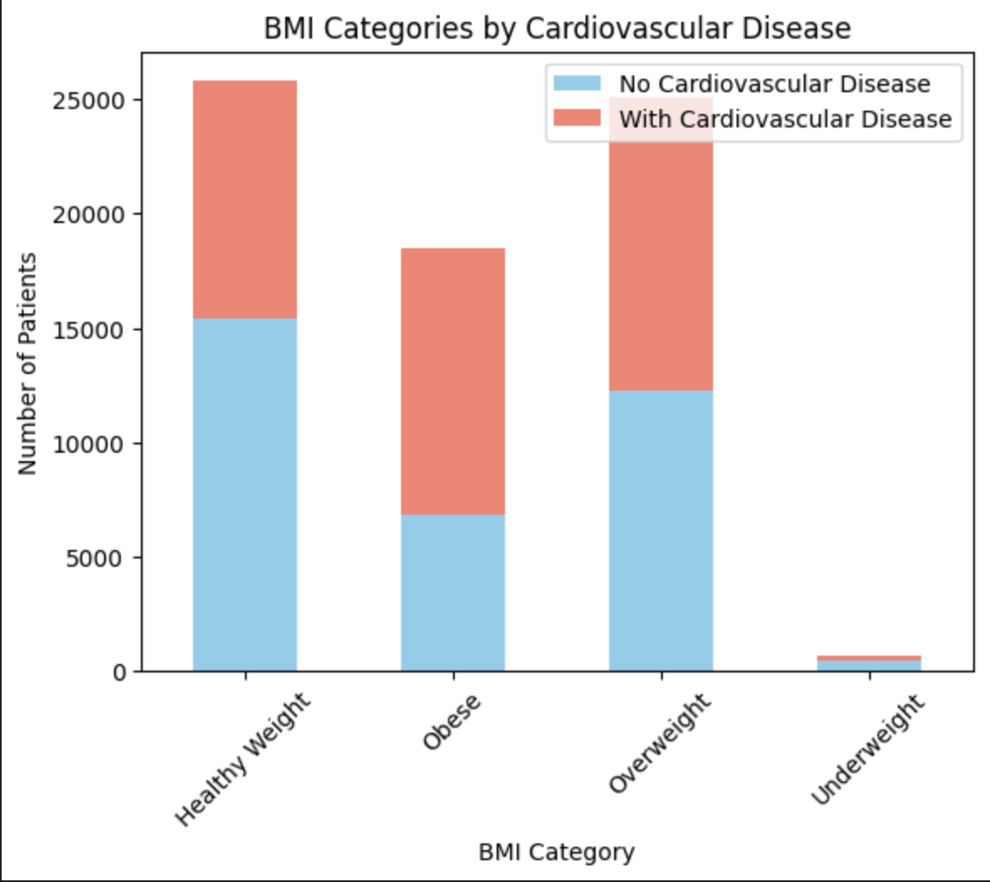
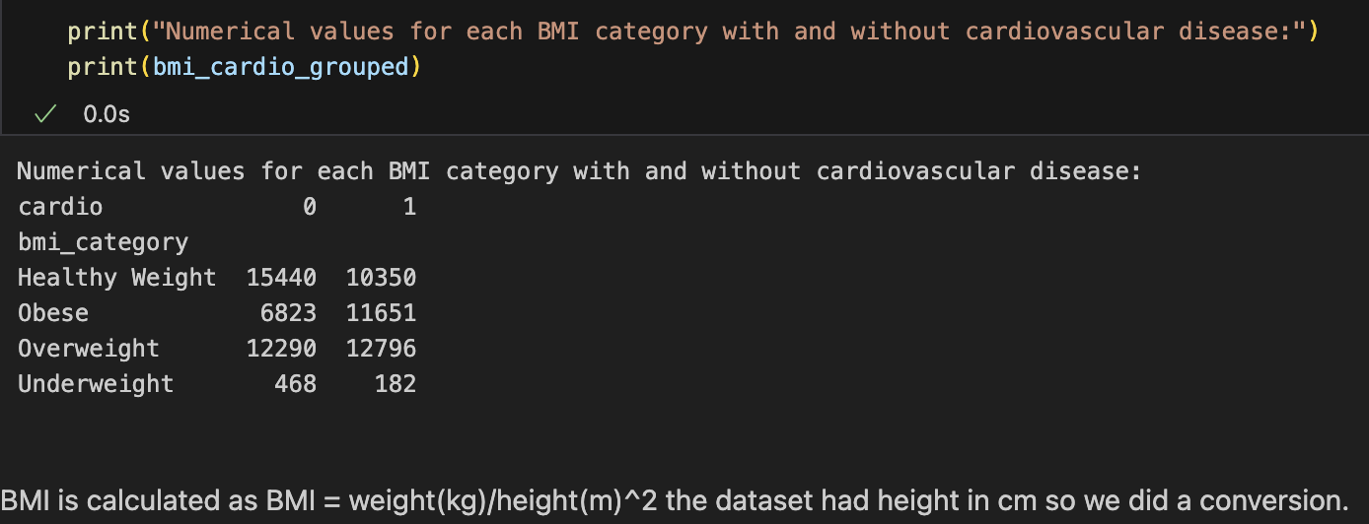
BMI
Finding the BMI gave clearer insight to which patients were more at risk for cardiovascular disease.

Slide 15
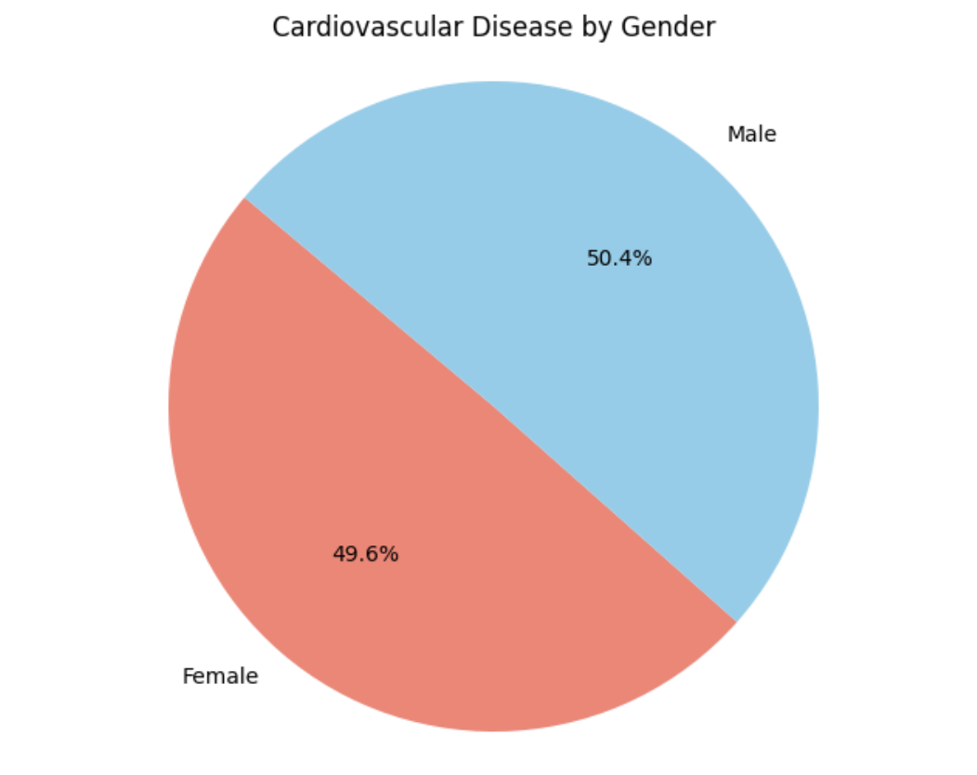
Cardiovascular Disease by Gender
We wanted to see what the correlation between Gender and cardiovascular disease was.

